Slide 1
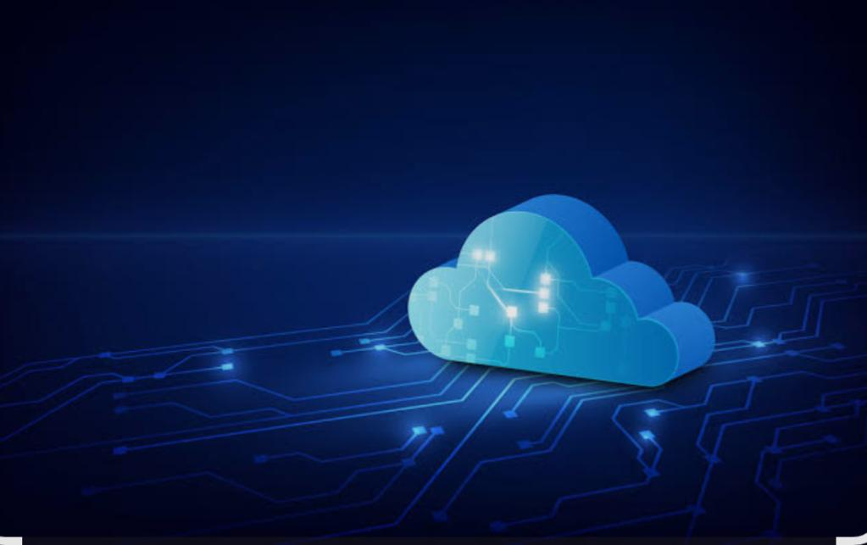
SRI BHARATHI WOMEN’S ARTS AND SCIENCE
COLLEGE KUNNATHUR ARNI
Presented by
S.SHALINI
BCA(COMPUTER APPLICATION)
REG NO:22924U09042
NM ID:BD8C13CFEE2EB6592574230A19BE6CD3
THIRUVALLUR UNIVERSITY

Slide 2
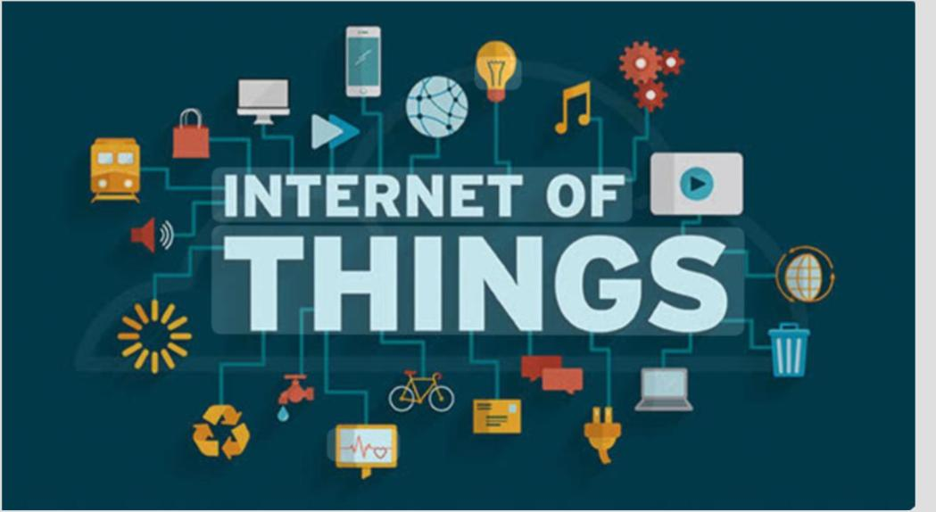

Slide 3
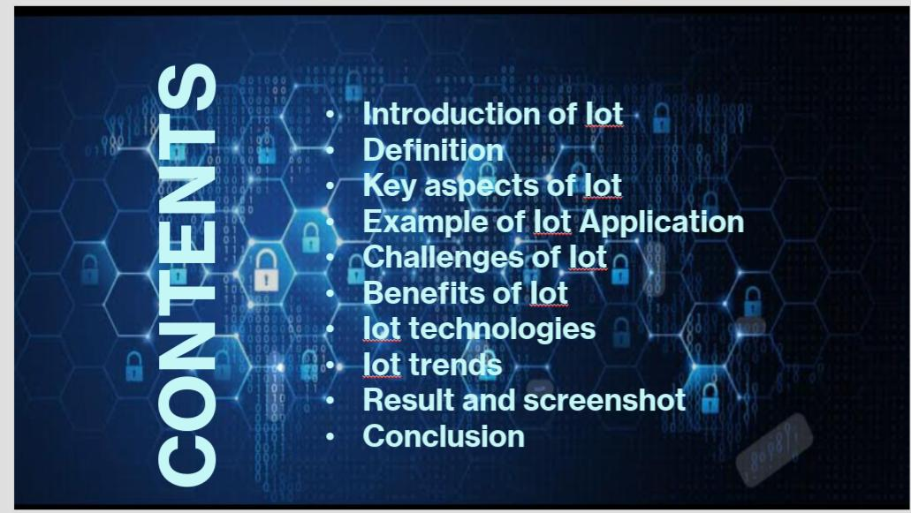

Slide 4
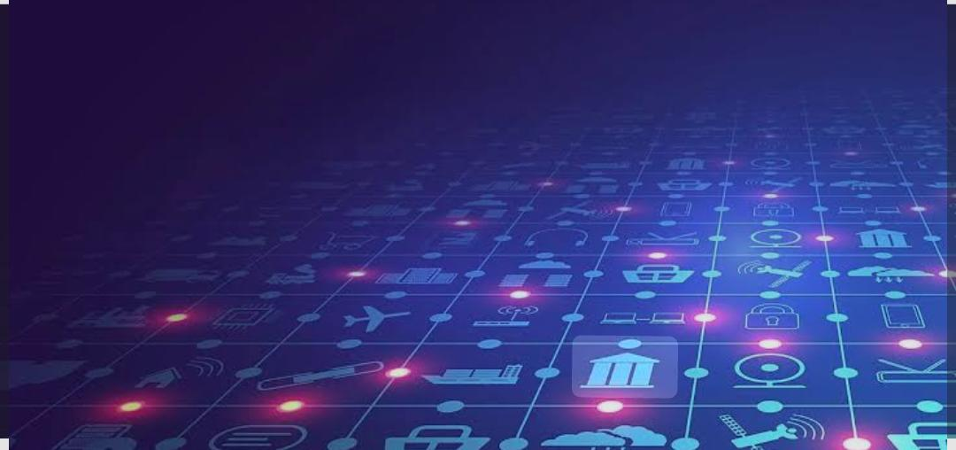
Introduction to Iot
The Internet of Things (IoT) refers to the network of physical objects—vehicles, buildings, appliances, and more—that are embedded with sensors, software, and other technologies to collect and exchange data over the internet, enabling communication without direct human intervention.

Slide 5

Definition
The Internet of Things (IoT) refers to the network of physical objects—or “things”—embedded with sensors, software, and other technologies that enable them to connect and exchange data over the internet with other devices and systems without direct human intervention.

Slide 6
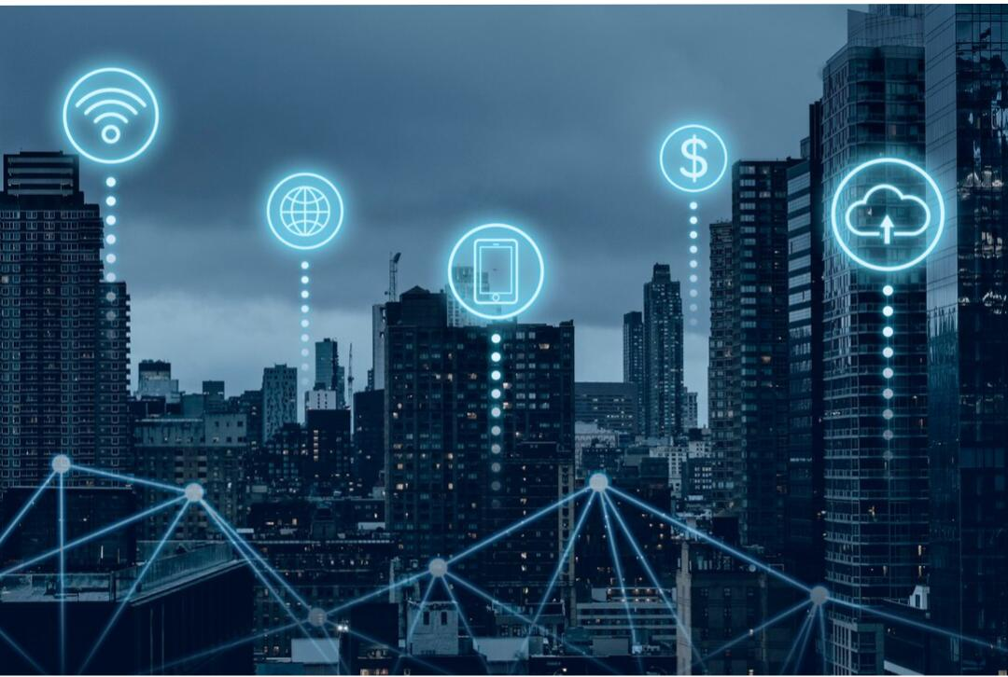
Key aspects of Iot
Key characteristics of the Internet of Things (IoT) include Connectivity to link devices, Sensing & Data Collection to gather information, Intelligence for data interpretation, Automation to perform actions without human intervention, Scalability to handle large numbers of devices, Interoperability to ensure diverse devices communicate, and Security & Privacy to protect data.

Slide 7
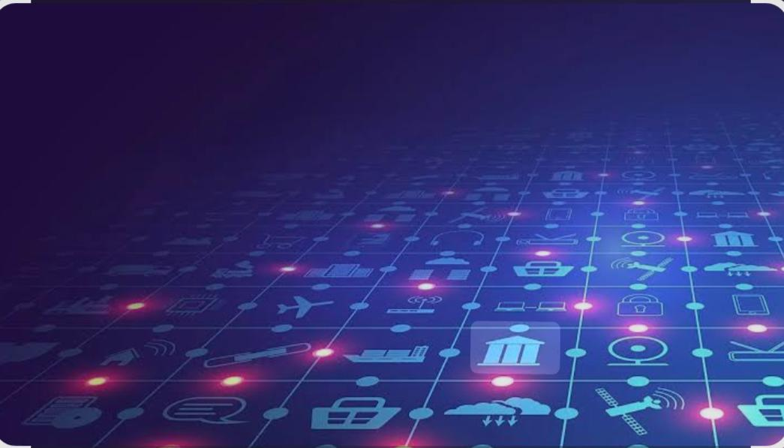
Example of Iot Application
IoT applications span various sectors, offering solutions for convenience, efficiency, and safety. In smart homes, devices like smart thermostats and security systems enhance comfort and security. Connected cars improve navigation and safety. Smart agriculture utilizes sensors for optimized irrigation and crop monitoring. Wearable devices track fitness and health. Industrial IoT applications automate manufacturing processes and improve supply chain management. Cities are becoming smarter with IoT-enabled traffic management, waste management, and public safety systems.

Slide 8

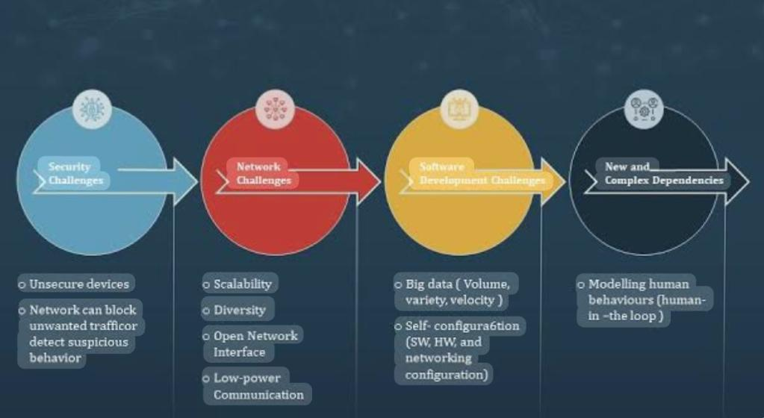
Challenges of Iot

Slide 9
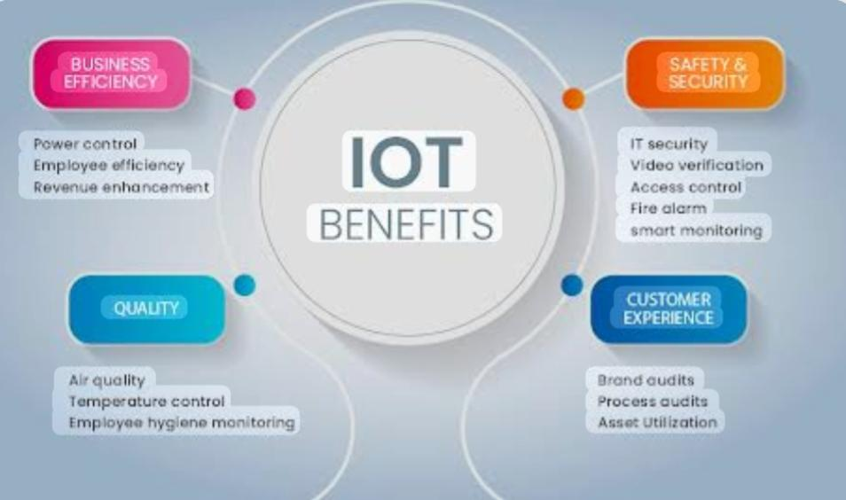
Benefits of Iot

Slide 10
The main advantages of the Internet of Things (IoT) include increased efficiency and productivity through automation and optimized processes, enhanced decision-making via real-time data collection and analysis, cost savings from resource management and waste reduction, and new opportunities for innovation by creating new products and business models.
Iot also improves customer experience by enabling personalized services and remote management, and it can enhance safety by monitoring environmental conditions and equipment to prevent accidents.

Slide 11
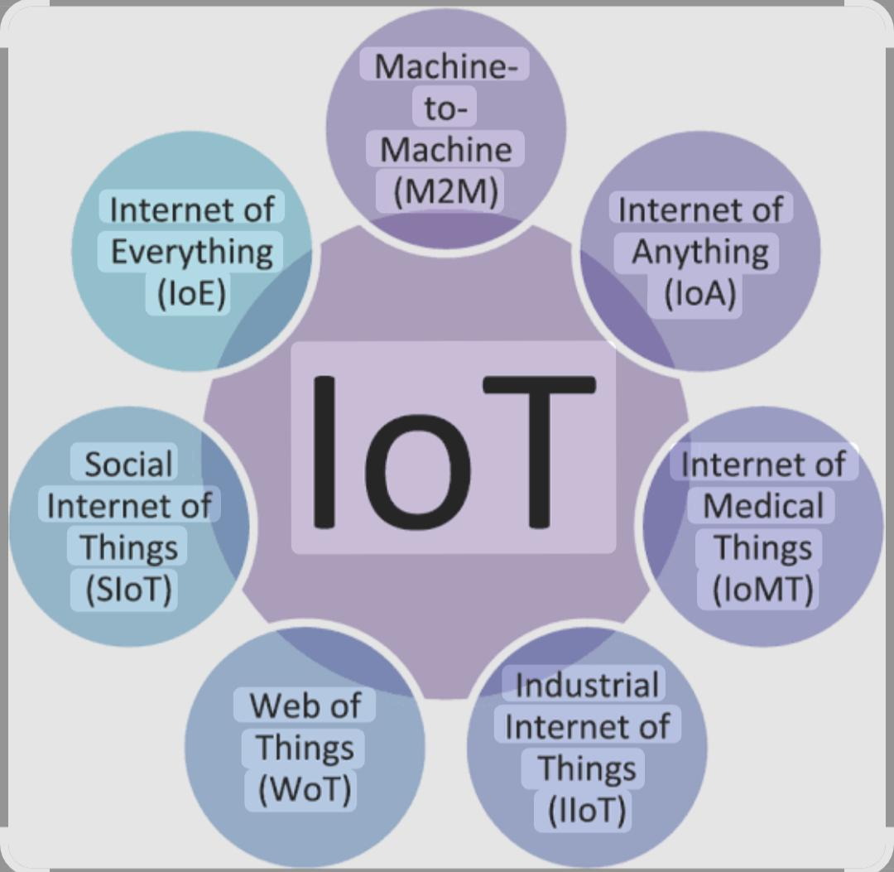
IoT Technologies

Slide 12
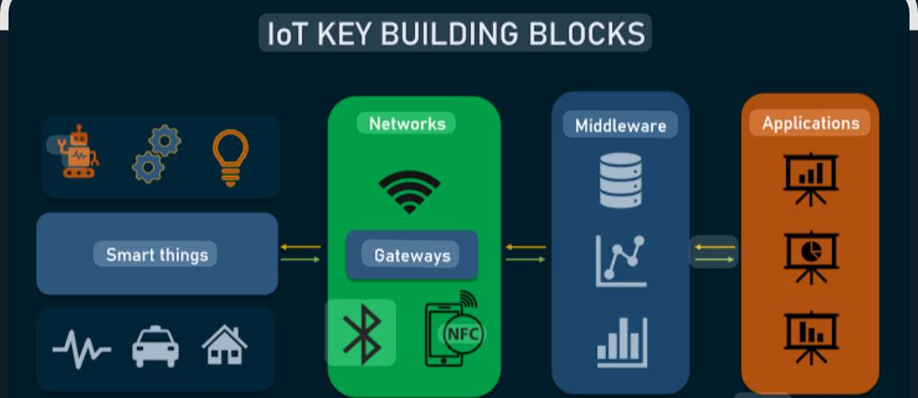

Slide 13
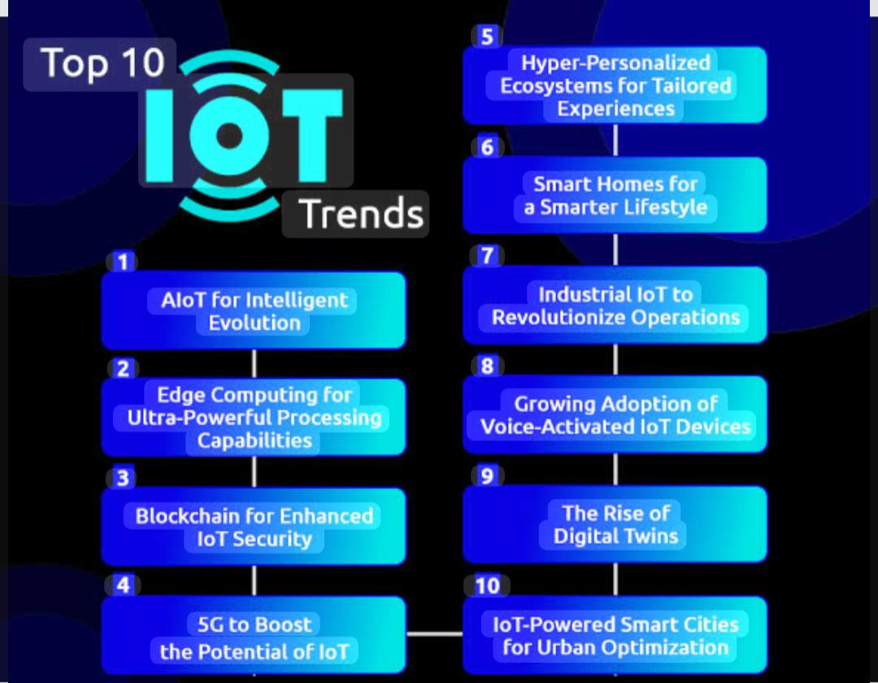
Iot trends
Iot trends

Slide 14
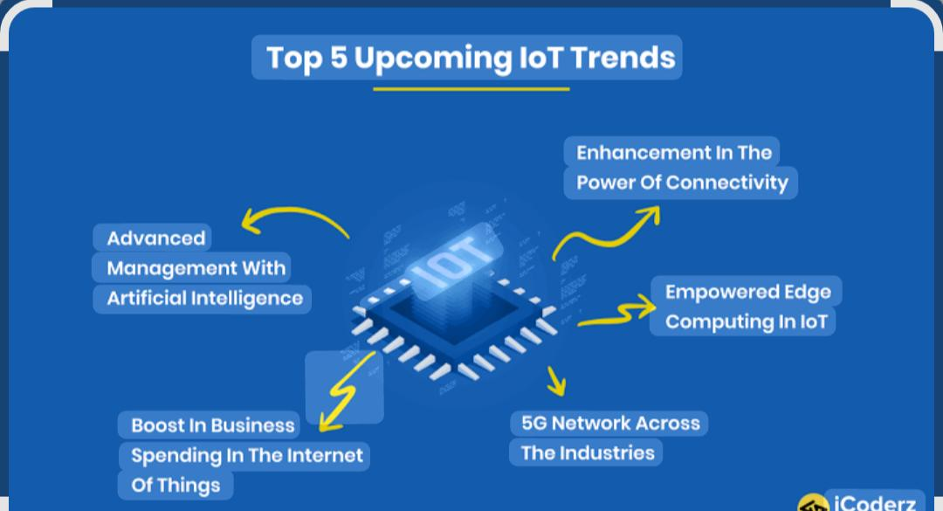

Slide 15




Result and screenshot

Slide 16
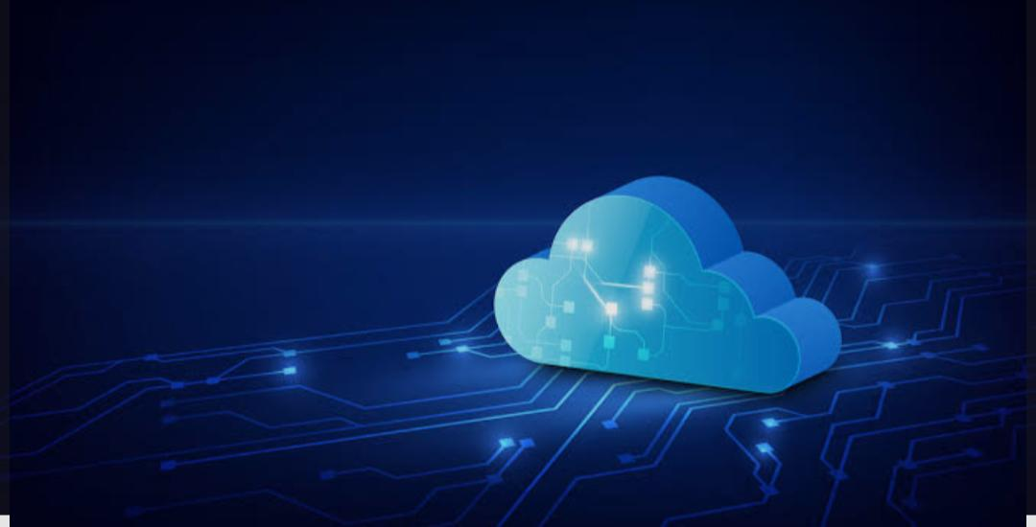
Conclusion
The Internet of Things (IoT) revolutionizes daily life and industries by connecting devices, leading to increased efficiency, automation, and convenience through smart homes, connected cities, and industrial optimization

Slide 17


